Slide 1
CS 201: Data Structures II Unit 01: Abstract Data Types
Habib University – Shaping Futures
Faisal Alvi
(For any suggested modifications please email: faisal.alvi@sse.habib.edu.pk)

Slide 2
Unit Outline
Introduction ADTs Math Background Model of Computation Correctness Summary Exercises
Introduction
Abstract Data Types
Mathematical Background (Results)
Model of Computation
Correctness, Time and Space Complexity
Summary
Exercises

Slide 3
Introduction
Introduction ADTs Math Background Model of Computation Correctness Summary Exercises
A data structure is a data organization, management, and storage format that is usually chosen for efficient access to data. (CLRS Book: Introduction to Algorithms)
Several important properties here:
Data Organization (Possible Example: A tree structure?)
Data Management (Possible Example: Operations on a data structure?)
Data Storage (Possible Example: A hashtable)
Efficient Access (Time Complexity, maybe?)

Slide 4
Data Structures
Introduction ADTs Math Background Model of Computation Correctness Summary Exercises
We interact with data structures constantly. Some examples:
Open a file on your PC
Look up a contact on your phone
Login to your favorite social network
Do a web search
Emergency Services
In several of these applications, efficiency is important – accessing a contact in your phone. In some others, it is critical such as an emergency.

Slide 5
Efficiency
Introduction ADTs Math Background Model of Computation Correctness Summary Exercises
Consider a linear implementation of data (i.e. a list). Suppose that we have a list of one million (10⁶) items.
Consider an application which has to access each of these 10⁶ items at least once.
If we have to scan the entire list to find each data item, then the total number of accesses will be 10⁶ x 10⁶ = 10¹²
With today’s computers performing ~ 10⁹ operations per second, it will take approximately 10¹² / 10⁹ = 10³ = 1000 seconds = 16 min 40 seconds to complete the entire operation.
Clearly, there is a need for an efficient data structure for this application.

Slide 6
Efficiency: Case Study
Introduction ADTs Math Background Model of Computation Correctness Summary Exercises
With billions of webpages, Google Search works within fractions of a second.
Furthermore, Google’s (and Bing’s) autocomplete feature gives predictions.
How does this autocomplete work, more specifically at the level of data structures?
The class can work in groups, with each group discussing their findings.

Slide 7
Abstract Data Types
Introduction ADTs Math Background Model of Computation Correctness Summary Exercises
In Object Oriented Programming, a typical class consists of both the data and the operations that can be performed on that data.
Objects from the class are instantiated which are actual instances of the class.
Functions/Methods
Data/Fields/Attributes
Class
Objects

Slide 8
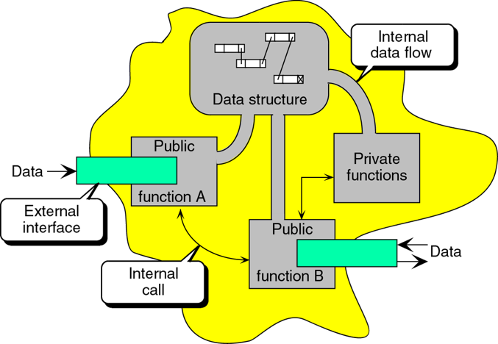
Abstract Data Types
Introduction ADTs Math Background Model of Computation Correctness Summary Exercises
An abstract data type (ADT) represents a data type along with the operations associated with that data type.
The implementation details are hidden from the users.
Users can interact with the data using the specified operations only.

Slide 9
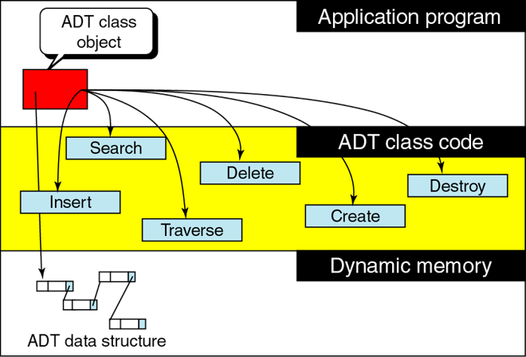
Abstract Data Types
Introduction ADTs Math Background Model of Computation Correctness Summary Exercises
ADT represents the interface to the data structure or type.
Interface tells what needs to be done.
Mechanism tells how it will be done.
Its important to separate the interface from the mechanism/implementation
It helps update the definition while keeping the same interface.
Users of the ADT can get a new (improved) implementation but use the same interface

Slide 10
Abstract Data Types – Queue, Stack, Deque
Introduction ADTs Math Background Model of Computation Correctness Summary Exercises
Here we present three abstract data types: queue, stack and deque.
In terms of ADTs we list their operations only.
These ADTs can be defined in terms of the List interface (or ADT) which represents a more generic linear data structure.
A Queue can be considered as a FIFO (first-in first-out) data structure.
A Stack can be considered as a LIFO (last-in first-out) data structure.
A Deque is a generalization of both Stacks and Queues.

Slide 11
ADTs – Queue
Introduction ADTs Math Background Model of Computation Correctness Summary Exercises
A queue is similar to a queue (or line-up) at a cash register in a grocery store.
This is the most common kind of Queue so the qualifier FIFO is used.
Operations supported by a queue are
add(item)
remove()
Items are removed in the same order they were added.
In other texts, the add(item) and remove() operations on a FIFO Queue are often called enqueue(x) and dequeue(), respectively.

Slide 12
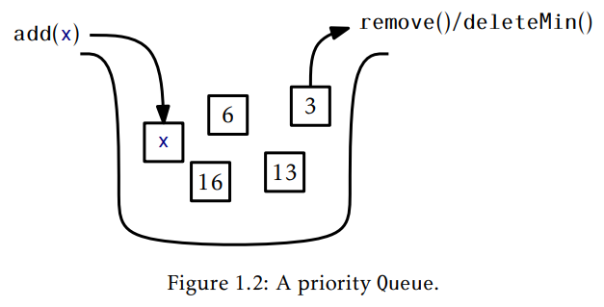
ADTs – Priority Queues
Introduction ADTs Math Background Model of Computation Correctness Summary Exercises
A priority Queue always removes the element with the highest priority from the queue.
Typically, this is the item with the minimum value – however priorities can be assigned based on some other criteria.
The remove() operation on a priority Queue is usually called deleteMin() in other texts.

Slide 13
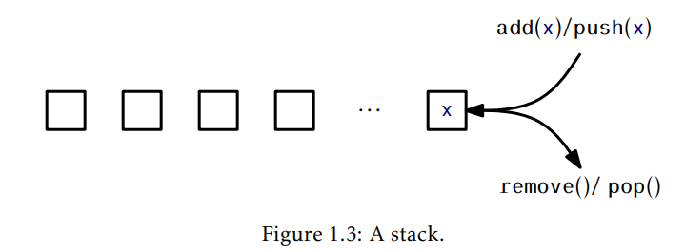
ADTs – Stacks
Introduction ADTs Math Background Model of Computation Correctness Summary Exercises
A Stack can be considered as a LIFO (last-in first-out) queue.
Operations supported by a stack are add(item) and remove(), typically called:
push(item)
pop()
Stacks are used in a wide variety of applications in Computer Science.

Slide 14
ADTs - Deque
Introduction ADTs Math Background Model of Computation Correctness Summary Exercises
A Deque is a generalization of both the FIFO Queue and LIFO Queue (Stack).
A Deque represents a sequence of elements, with a front and a back.
Elements can be added at the front of the sequence or the back of the sequence.
The names of the Deque operations are self-explanatory:
addFirst(item), removeFirst(), addLast(item), removeLast().
It is worth noting that a Stack can be implemented using only addFirst(item) and removeFirst()
A FIFO Queue can be implemented using addLast(x) and removeFirst()

Slide 15
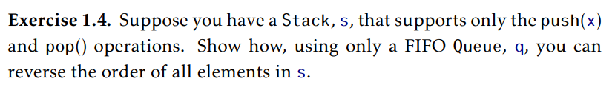
Class Exercise
Introduction ADTs Math Background Model of Computation Correctness Summary Exercises

Slide 16
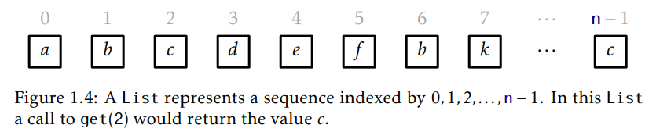
ADTs – The List Interface
Introduction ADTs Math Background Model of Computation Correctness Summary Exercises
The List interface is a sequence of n data items: x₀, x₁, …, x_{n – 1}.
A List allows indexed access to data items – effectively providing random access.
The List interface supports the following operations.
size(): return n, the length of the list,
get(i): return the value x_{i},
add(i,x): add x at index i, displacing x_{i}, …, x_{n − 1};
remove(i) remove the value x_{i} , displacing x_{i +1}, …, x_{n − 1};

Slide 17
Class Exercise
Introduction ADTs Math Background Model of Computation Correctness Summary Exercises
Implement the Stack, Queue and the Deque abstract data types using the List interface.

Slide 18
ADTs – The USet Interface (Unordered Set)
Introduction ADTs Math Background Model of Computation Correctness Summary Exercises
The USet interface represents an unordered set of unique elements, which mimics a mathematical set.
A USet contains n distinct elements - no element appears more than once and the elements are in no specific order.
A USet supports the following operations:
size(): return the number, n, of elements in the set
add(x): add the element x to the set if not already present
remove(x): remove x from the set;
find(y): Find an element y in the set if it exists.

Slide 19
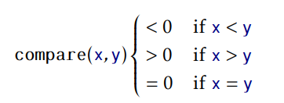
ADTs – The SSet Interface (Sorted Set)
Introduction ADTs Math Background Model of Computation Correctness Summary Exercises
The SSet interface represents an ordered set of unique elements, which mimics a mathematical set.
Elements in an SSet can be compared with a method called compare(x, y):
Apart from compare, an SSet supports the same operations as a USet.
However, the find operation in an SSet finds the smallest element that is greater than or equal to its argument.

Slide 20
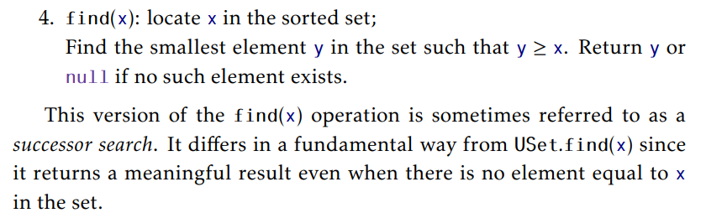
ADTs – find(x) in an SSet
Introduction ADTs Math Background Model of Computation Correctness Summary Exercises

Slide 21
Exercise(s)
Introduction ADTs Math Background Model of Computation Correctness Summary Exercises
We gave a brief description of the USet ADT (it implements an unordered set data type). What is the difference between the find(item) operation of a USet and that of an SSet. Give arguments in terms of output as well as efficiency.

Slide 22

Mathematical Background (Results)
Introduction ADTs Math Background Model of Computation Correctness Summary Exercises
Exponentials and Logarithms:
Typically, we use log₂ in Computer Science.
Asymptotic Notation: Big-O, Big-Ω and Big-Θ notation.
Factorials.
Average or Expected Running Times

Slide 23
Model of Computation
Introduction ADTs Math Background Model of Computation Correctness Summary Exercises
We use the we use the w-bit word-RAM model as our model of computation, where RAM stands for Random Access Machine.
In the word-RAM model, basic operations on words take constant time.
This includes arithmetic operations (+, −, ∗, /, %), comparisons (, =, ≤, ≥), and bitwise boolean operations (bitwise-AND, OR, and exclusive-OR).
Allocating a block of memory of size k takes O(k) time and returns a reference (a pointer) to the newly-allocated memory block.

Slide 24
Correctness, Time and Space Complexity
Introduction ADTs Math Background Model of Computation Correctness Summary Exercises
When studying the performance of a data structure, there are three things that matter most:
Correctness: The data structure should correctly implement its interface.
Time complexity: The running times of operations on the data structure should be as small as possible.
Space complexity: The data structure should use as little memory as possible.

Slide 25
Summary
Introduction ADTs Math Background Model of Computation Correctness Summary Exercises
In this session we gave an introduction to the field of data structures by primarily introducing several abstract data types.
The Queue, Stack and Deque are basic ADTs which can be derived from the the List ADT.
We also studied the USet and SSet ADTs which represent the unsorted set and the sorted set ADTs.
We use the RAM Model of Computation,
When constructing and analyzing Data Structures, correctness, time complexity and space complexity are important parameters.

